Slide 1
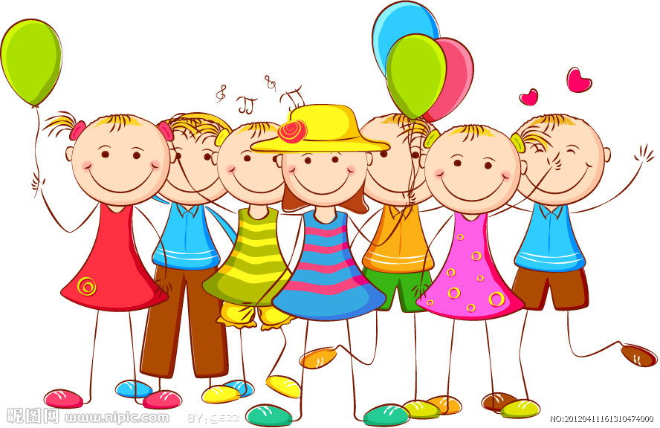
M2U2 That’s my family
Peter’s Family

Slide 2
Learn the letters!
I
J
j
i
insect
jar
if
jam
ill
jump

Slide 3
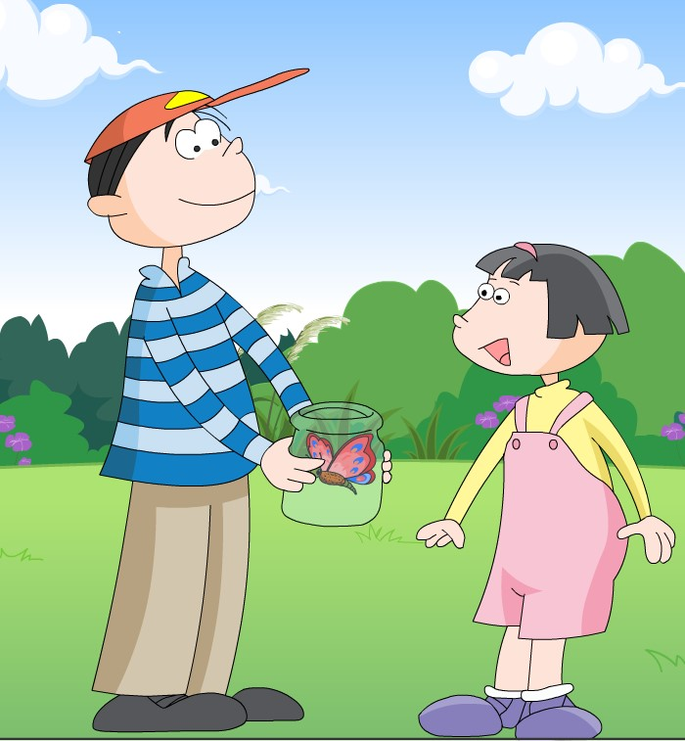
Let’s read!
Harry has a jar.
Harry has a jar.
Harry has an insect.
An insect in a jar.

Slide 4
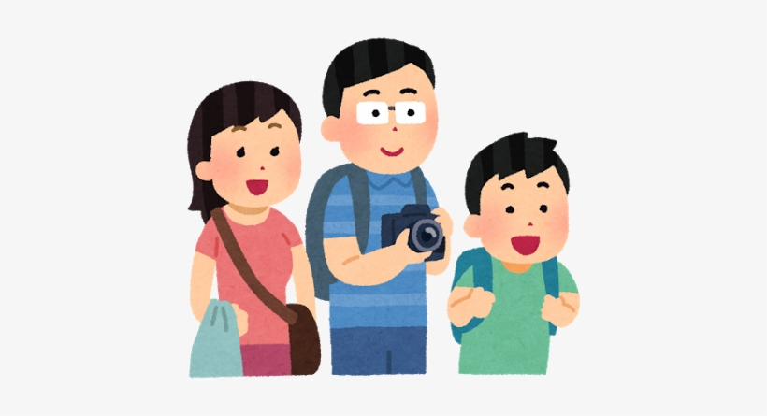
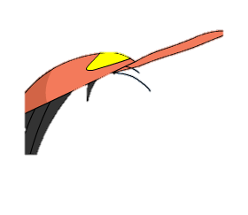
Let’s talk!
Look! This is my family.
He’s my ________.
He’s __________.
He can___________.
She’s my _________.
She’s __________.
She can ________.
I love my family.

Slide 5
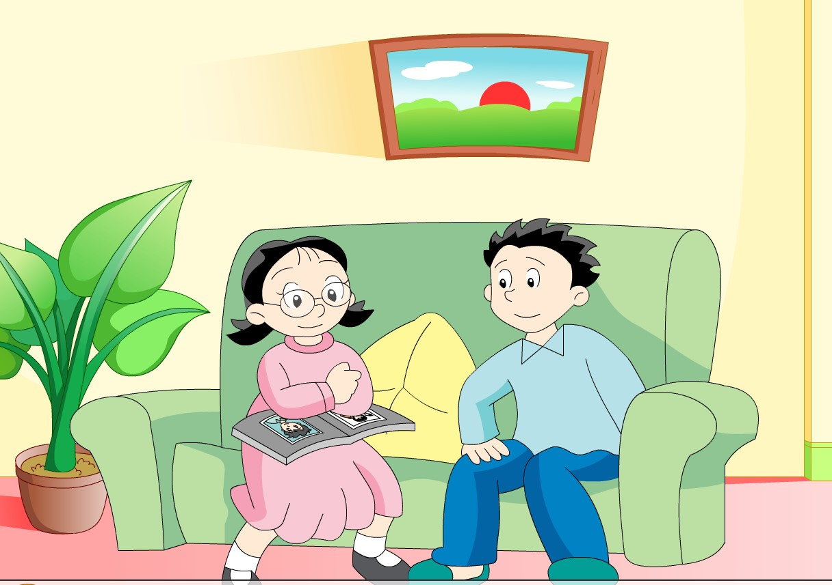

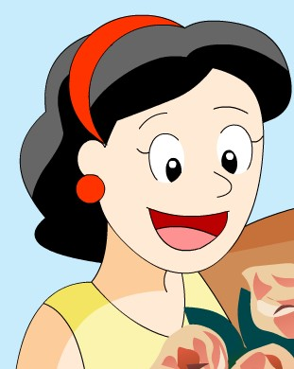
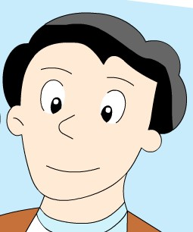


Let’s act!
Look! She’s my mother.
Wow! She’s so young!
Yes. She’s kind and dear.
Who’s he?
How cool!
He’s my father. He’s big and tall. He can swim like a fish.
Notes:
Look! Kitty and Peter are talking about their family too. Let’s listen. 复习

Slide 6

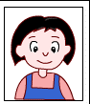
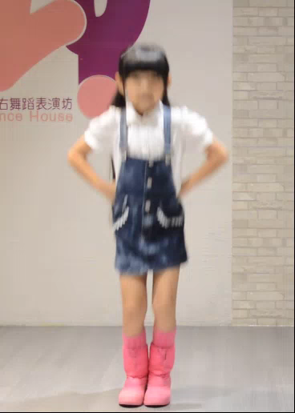
She’s Sally.
Who’s she?
Is she your sister?
Yes, she is. Look!
She can dance well.
Wow! So nice!

Slide 7
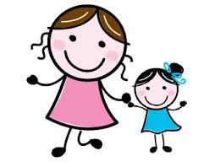
s_ster
姐姐,妹妹
i
big sister
姐姐
little sister
妹妹

Slide 8
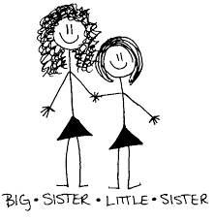

Let’s chant!
Sister, sister.
Big big sister.
Sister, sister.
Little little sister.
Sister, sister.
Thin and nice.
Notes:
教完，回到对话

Slide 9
She’s Sally.
Who’s she?
Is she your sister?

Slide 10
Is she your sister?
Is she nice?
Is she lovely?
Notes:
Look. She’s Sally. Is she Ben’s sister? Yes. Learn is she…? 加入No she isn‘t.

Slide 11
Let’s act!
She’s Sally.
Who’s she?
Is she your sister?
Yes, she is. Look!
She can dance well.
Wow! So nice!

Slide 12

He’s Jim.
Who’s he?
Is he your brother?
No, he isn’t.
He’s my friend.
We can play football.
We are happy!

Slide 13
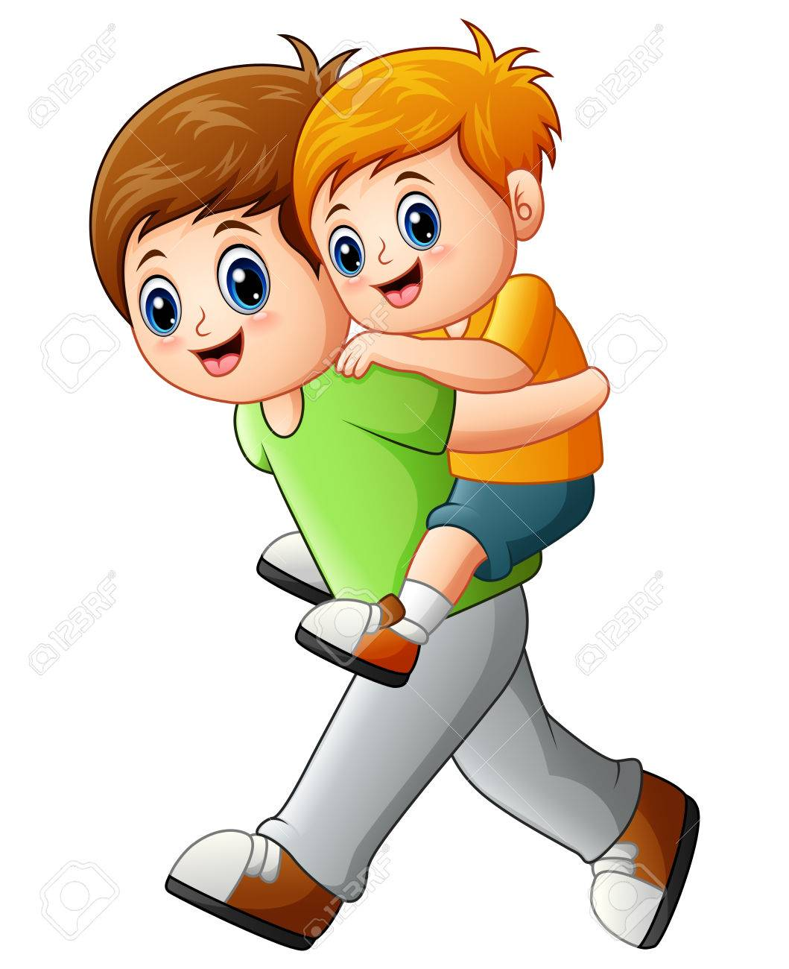
br
m
other
哥哥，弟弟
big brother
哥哥
little brother
弟弟

Slide 14
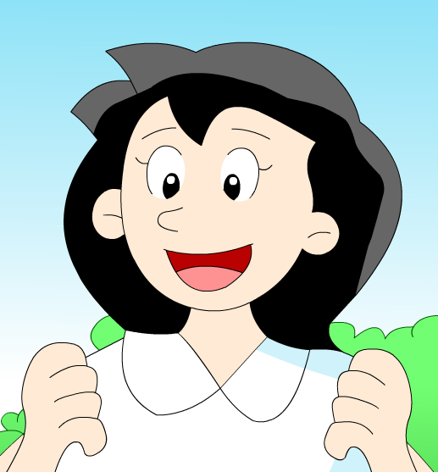
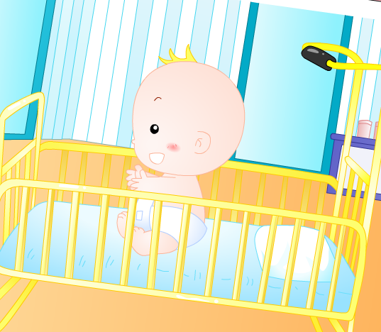
Let’s chant!
She’s my sister.
Thin and nice.
He’s my brother.
Sweet and small.
Notes:
After: 回到对话，直接出Is he

Slide 15
Is he your brother?
他是你的兄弟吗？
No, he isn’t.
Is he your friend?
Yes, he is.

Slide 16
Let’s chant!
Is she，is she,
Is she your sister？
Yes，yes. Yes, she is.
Is he, is he,
Is he your brother?
No, no. No, he isn’t.

Slide 17
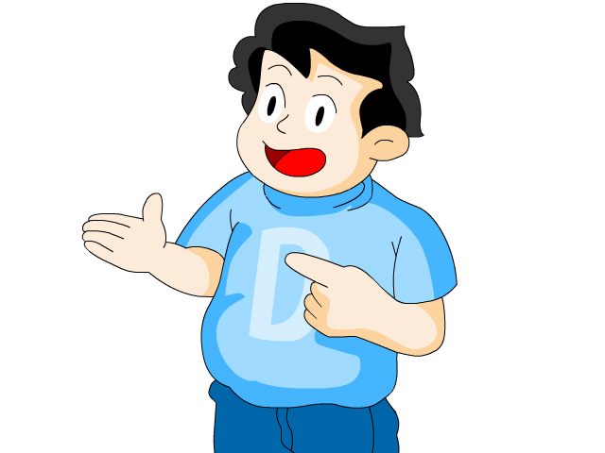
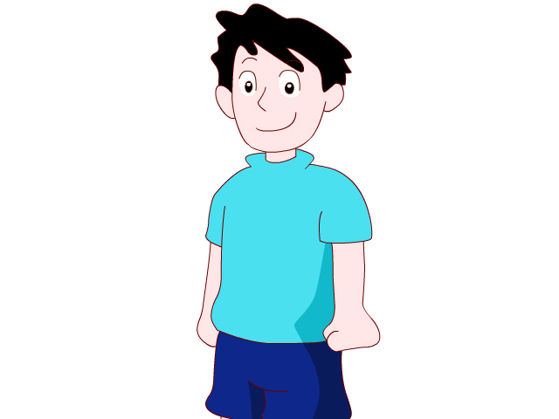
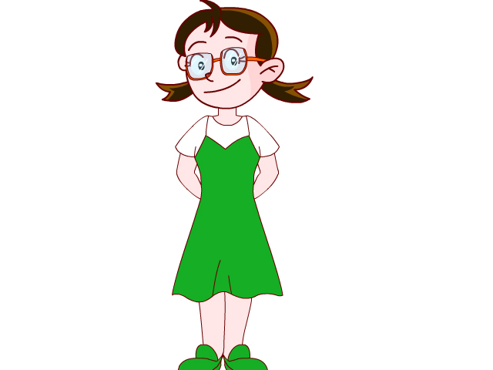
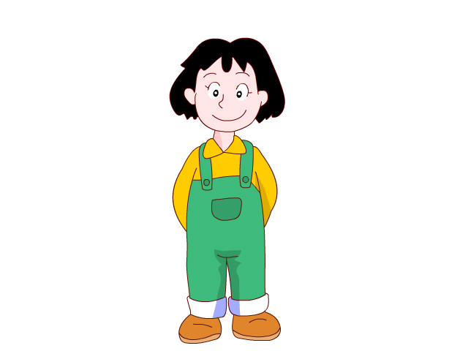
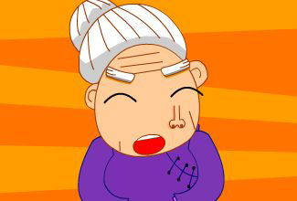
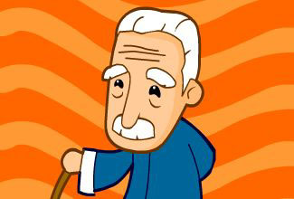
Try to say:
A:
B:
Is he/ she _____?
Yes, he/she is .
No, he /she isn't .
thin
fat
tall
short
old
young
big
small

Slide 18
Let’s act:
He’s Jim.
Who’s he?
Is he your brother?
No, he isn’t.
He’s my friend.
We can play football.
We are happy!

Slide 19
Look! She’s my mother.
Wow! She’s so young!
Yes. She’s kind and dear.
Who’s he?
How cool!
He’s my father. He’s big and tall. He can swim like a fish.
Notes:
Look! Kitty and Peter are talking about their family too. Let’s listen. 复习

Slide 20
She’s Sally.
Who’s she?
Is she your sister?
Yes, she is. Look!
She can dance well.
Wow! So nice!

Slide 21
He’s Jim.
Who’s he?
Is he your brother?
No, he isn’t.
He’s my friend.
We can play football.
We are happy!

Slide 22
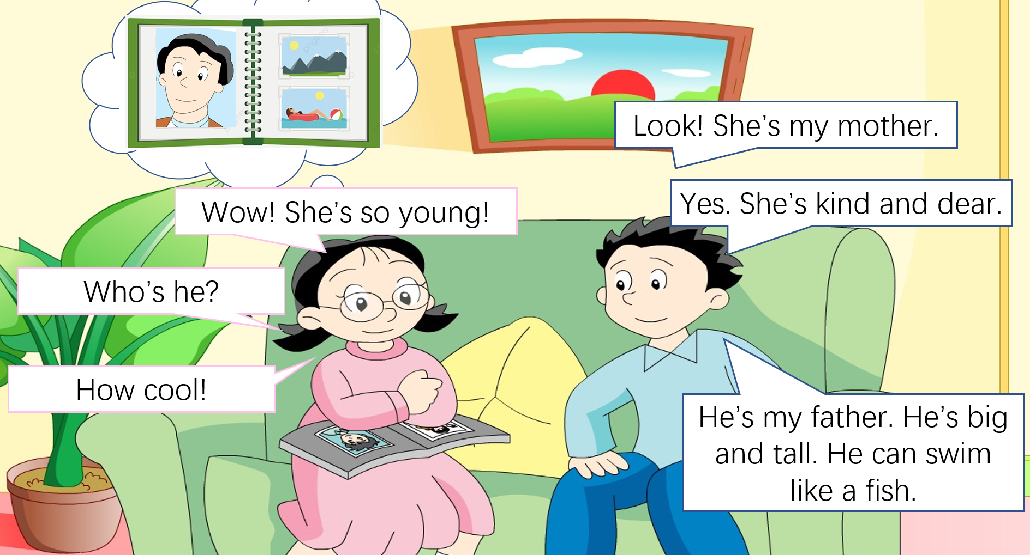
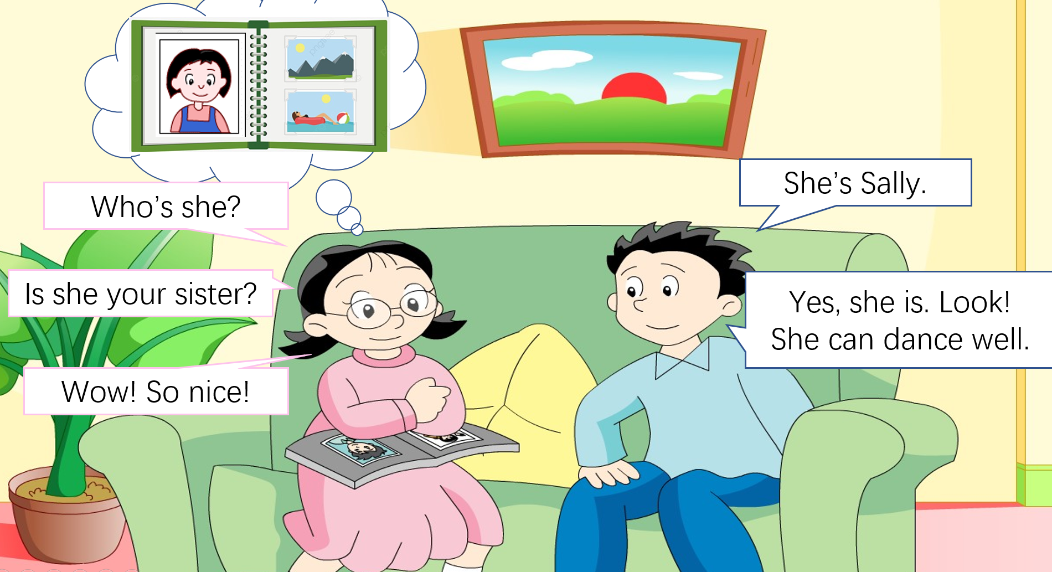
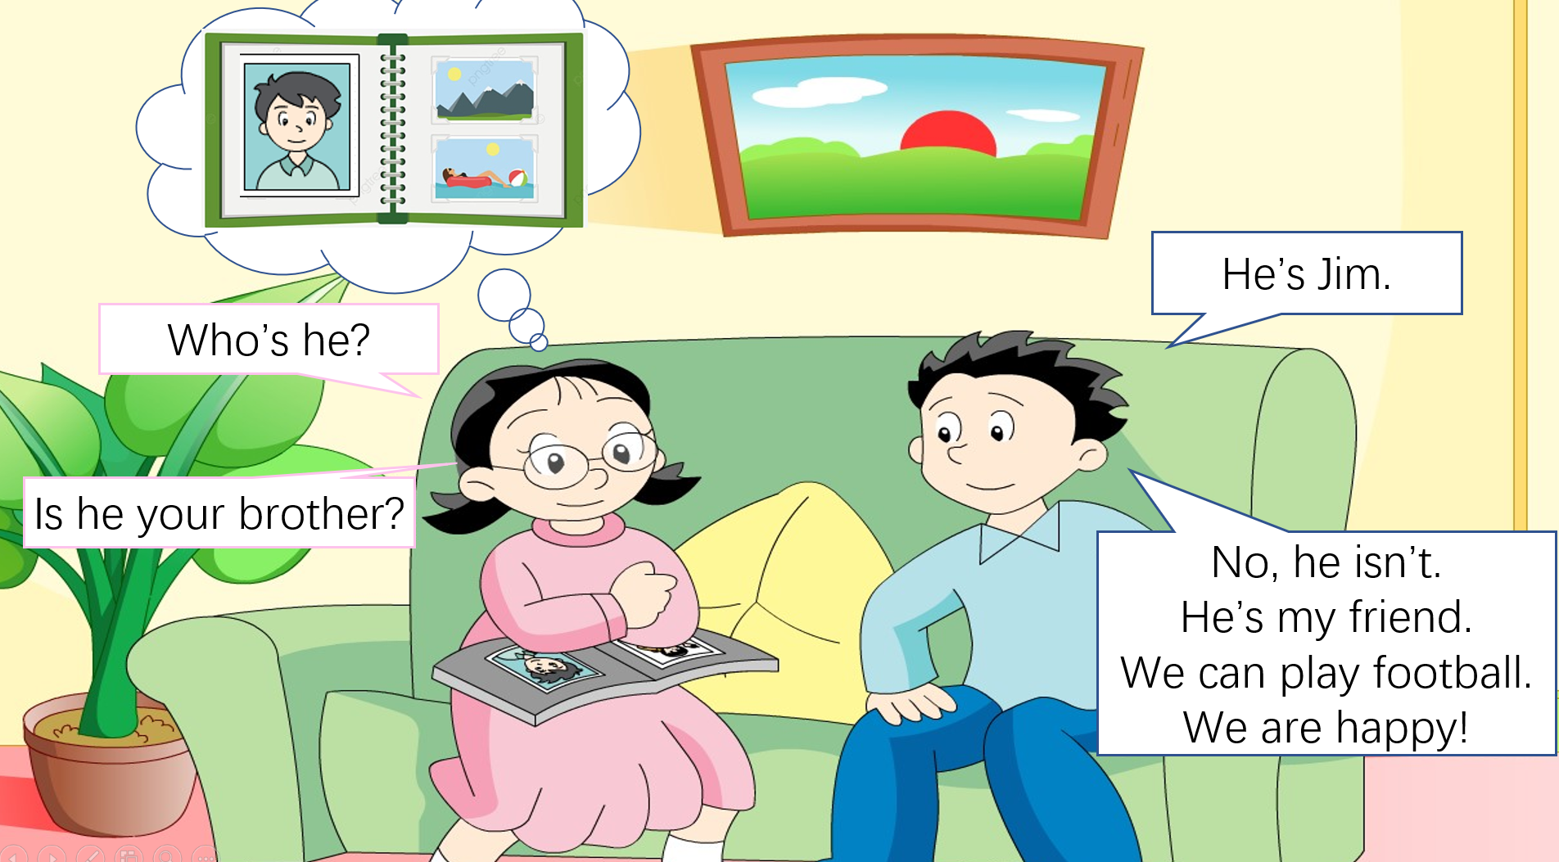
2
1
3
Notes:
How many ppl in Ben’s family? There are four ppl. Father mother sister and Ben. They are very happy. Let’s enjoy the whole dialogue.

Slide 23
She's my mummy,
Kind and dear.
善良
亲切
He's my daddy,
Big and tall.
She's my sister,
Thin and nice.
He's my brother,
Sweet and small,
甜美，可爱
Notes:
Ben’s loves his family very much. He writes a poem for his family. Look.

Slide 24
Ben: Look! She’s my mother.
Kitty: Wow! She’s so young.
Ben: Yes. She’s kind and dear.
Kitty: Who’s he?
Ben: He is my father. He’s big and tall. He can swim like a fish.
Kitty: How cool.
Kitty: Who’s she?
Ben: She’s Sally.
Kitty: Is she your sister?
Ben: Yes, she is. Look, she can dance well.(插入视频)
Kitty: Wow. So nice!
Kitty: Who’s he?
Ben: He’s Jim.
Kitty: Is he your brother?
Ben: No, he isn’t. He’s my friend. We can play football. We are happy.

